Slide 1
Foundation Training for Teachers’ under DTE
Module-6.05
TVET & SOCIAL MEDIA
DR. Sheikh Abu Reza
Director (Rtd) DTE &
CBT&A Trainer

Slide 2
1. The concept of TVET 2. TVET scenario of Bangladesh 3. The concept of social media 4. Social Media, Social networking and E-learning 5. Channels of performing activities in social media 6. Advantages and disadvantages of social network in education 7. Some Examples
Outlines

Slide 3
TVET

Slide 4
TE = Technical Education (All type of Diploma Courses )
VE = Vocational Education ( SSC Voc & HSC Voc under BTEB)
T = Training( All Ministry)

Slide 5
Quality issues in TVET
TVET may varied in country to country and institute to institute for different factors, context and environments- traditional TVET-
Not consistent about QA
Not Standards alien with demanded occupations
Curriculum not based on needs
TVET teachers and trainers are not properly trained
Lack of strong and appropriate TVET governance
Skills training is problematics
Recruitment rules are defective and time consuming
P-60

Slide 6
QAM (Quality Assurance Manuals)
CAD ( Course Accreditation Documents)

Slide 7
P-31

Slide 8
National Skills Development Policy of Bangladesh, updated around 2020–2023
Demand-Driven Skill Development
Inclusive Access
Quality Assurance
Public-Private Partnership
Recognition of Prior Learning
Use of Technology
Sustainable Financing
Institutional Strengthening
Monitoring and Evaluation
Green Skills and Future Skills

Slide 9
P-34

Slide 10
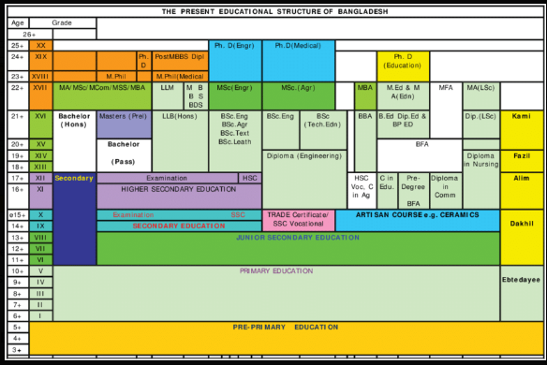
Bangladesh National Qualifications Framework (BNQF)

Slide 11
Two pre-vocational levels to allow easier access to formal TVET for poor or under privileged groups who might not have sufficient formal schooling and lack of literacy and numeracy but having skills either working in different economic sector or have no works at all.
Structure of BNQF:
Levels 1–6: Focus on Technical and Vocational Education and Training (TVET) and skills development.
Levels 7–10: Pertains to Higher Education qualifications, including bachelor's, master's, and doctoral degrees.
P-34

Slide 12
P-37

Slide 13
P-53

Slide 14
Social media, Social networking and E-learning
Social media is a way for people to connect and
interact online.
It lets users create, share, and exchange information
and ideas.
It includes internet-based apps and platforms
like Facebook, WhatsApp, YouTube, etc.
Social media is built on internet technology and
allows users to post their own content

Slide 15
Types of Social Media
1. Social Networks - Connect with people (Facebook, Twitter, LinkedIn ) 2. Messaging Apps - Message privately (WhatsApp, Messenger, WeChat ) 3. Photo/Media Sharing - Share photos, videos and more (Instagram, YouTube) 4. Blogging & Publishing Networks - Long format content 5. Interactive Apps - Connect, create and share content (Snapchat, TikTok ) 6. Discussion Forums - Share knowledge, news and ideas (Quora, Reddit) 7. Bookmarking & Content Curation - Discover, save and share content 8. Review Network - View and publish reviews 9. Social Shopping Networks - Shop online 10. Interest Based Networks - Explore hobbies and interests 11. Sharing economy networks - Trade goods and services 12. Audio only apps - Join discussions, share ideas and knowledge on audio 13. Anonymous Social Networks - Post anonymously

Slide 16
Social Networking
A social networking service is a platform where people connect with others.
It helps build relationships based on shared interests, activities, or real-life connections.
Social networking is one of the most popular uses of the internet today.
These platforms help users stay in touch with friends and also support professional networking.

Slide 17
Advantages of Social Networking
Connect to Other People All Over the World.
Easy and Instant Communication.
Real-Time News and Information Discovery.
Great Opportunities for Business Owners.
General Fun and Enjoyment.
Information Overload and Overwhelm.
Privacy Issues.
Social Peer Pressure and Cyber Bullying.

Slide 18
Disadvantages of Social Networking
Lacks Emotional Connection. ...
Gives People a License to be Hurtful. ...
Decreases Face-to-Face Communication Skills. ...
Conveys Inauthentic Expression of Feelings. ...
Diminishes Understanding and Thoughtfulness. ...
Causes Face-to-Face Interactions to Feel Disconnected. ...
Facilitates Laziness.

Slide 19
E-learning
E-learning is a type of learning that uses electronic tools and resources.
It can take place inside or outside the classroom using computers and the internet.
E-learning helps deliver education to many people at the same or different times.
At first, it was not fully accepted because people thought it lacked human interaction.

Slide 20
E-learning management system
E-learning courses are usually run through a Learning Management System (LMS).
An LMS is a software platform (often web-based) that helps manage and deliver training.
It supports online courses, tracks learner progress, and automates tasks like reporting and content organization.
It saves time and reduces manual work for trainers and institutions.

Slide 21


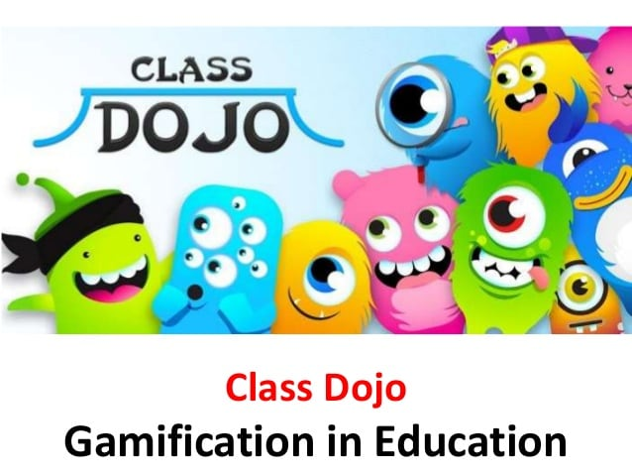




Teaching platforms for teachers

Slide 22
Google Classroom
YouTube Link

Slide 23
Education Management Website
Ideal Institute of Science & Technology ( IIST )
E- Campus: Blended Learning Platform of DTE through LMS

Slide 24
6 Bangladeshi platforms
1. E-Campus: Blended Learning Activities of DTE through LMS
2. 10-Minute School: A modern platform for the contemporary learners
3. Shikkok Batayon: A Teaching platform for the Teachers!
4. StudyPress: 'Automating' learning to combat the curse of unemployment
5. Repto Education Centre: A destination for Bangladeshi online content creators and freelance-aspirants
6. Amar Pathshala: Free education for all from any corner of the world

Slide 25

Review

Slide 26


